Slide 1
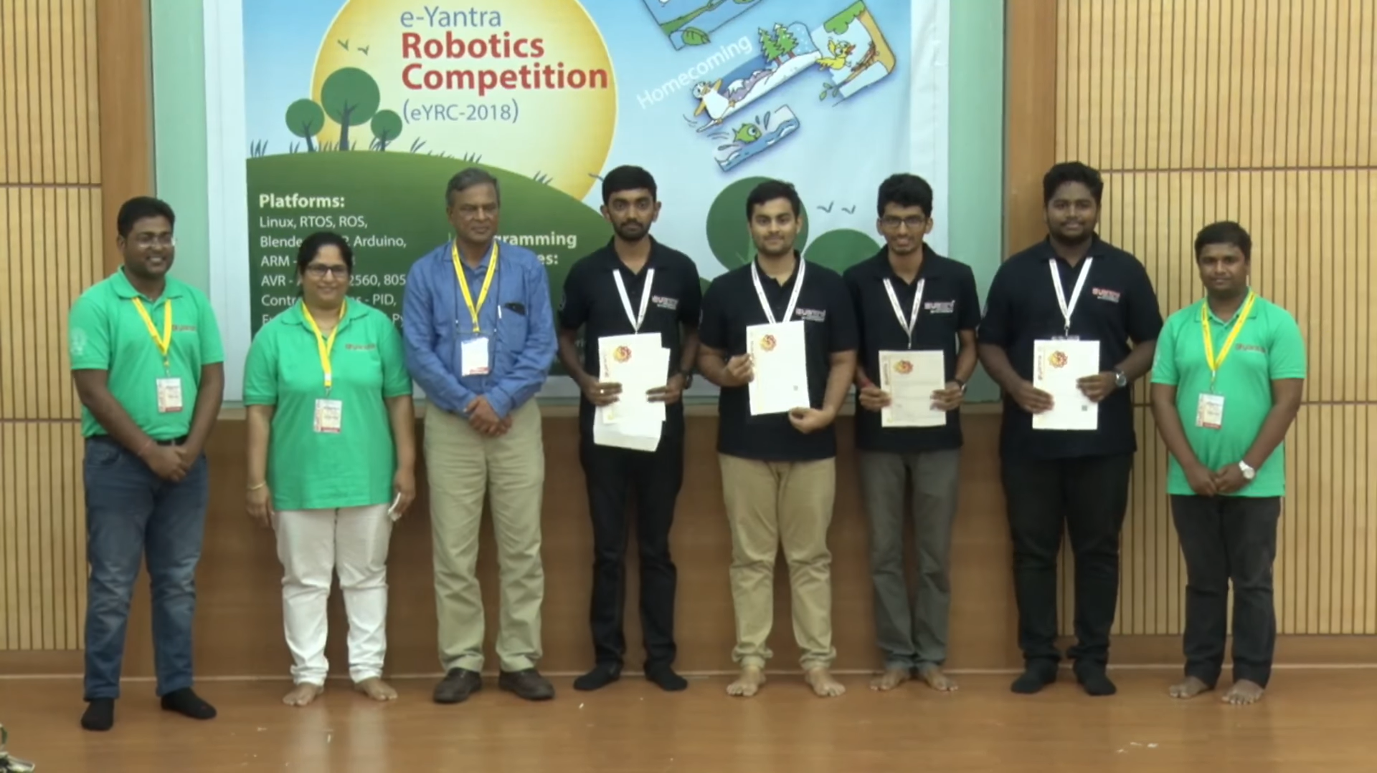
1st Prize
Team Members:
Karthik K Bhat 2nd Year ECE
Vishwas N S 2nd Year CSE
Suryanarayan N 2nd Year CSE
Shreyas R 2nd Year ECE

Slide 2
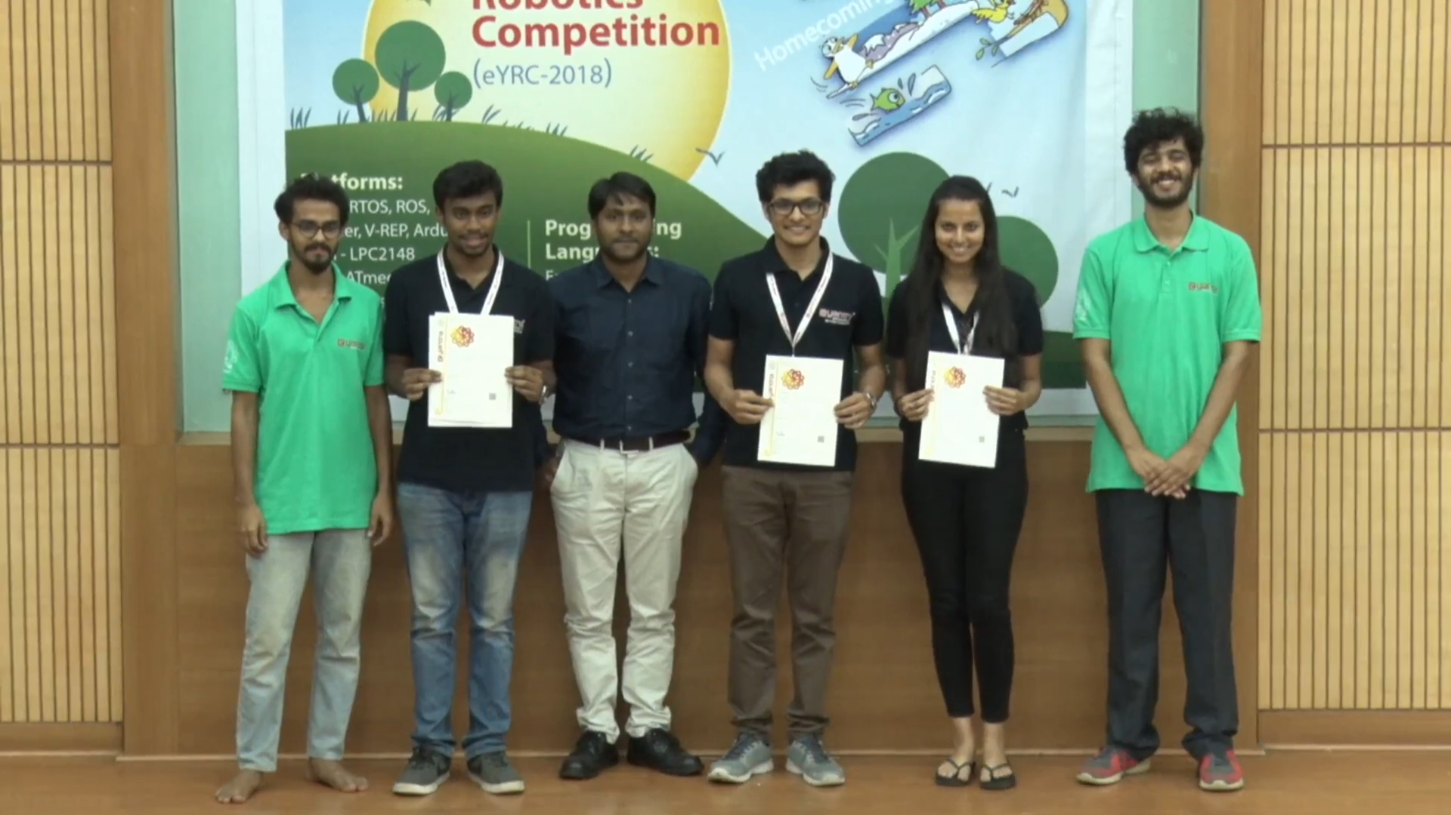
3rd Prize
Team Members:
Nandakrishna 2nd Year CSE
Rahul G 2nd Year ECE
Shubha M 2nd Year CSE

Slide 3
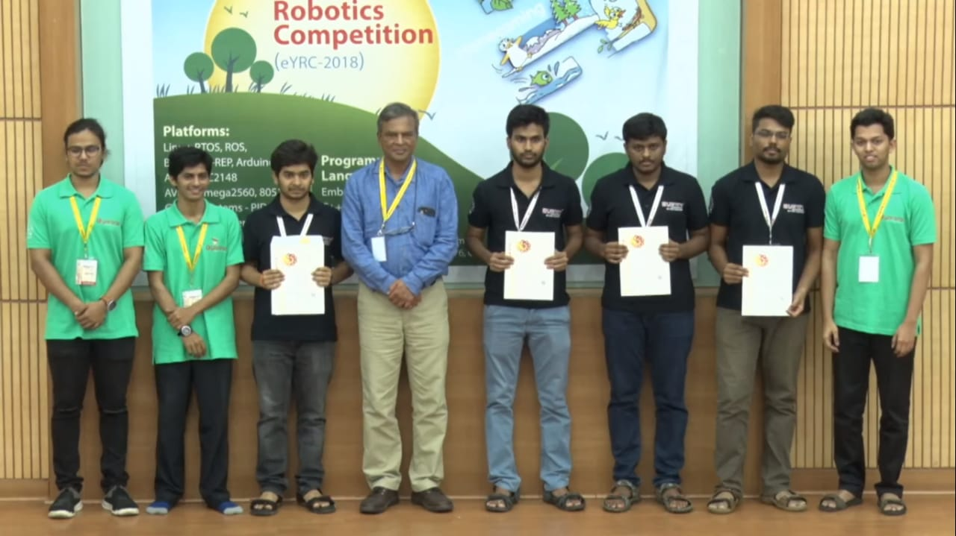
Consolation Prize
Team Members:
Karthik P Bilichod 3rd Year ECE
K U Varunkumar 3rd Year ECE
Kantesh A Balulad 3rd Year ECE
Kartik Vishnu Hegde 3rd Year ECE

Slide 4
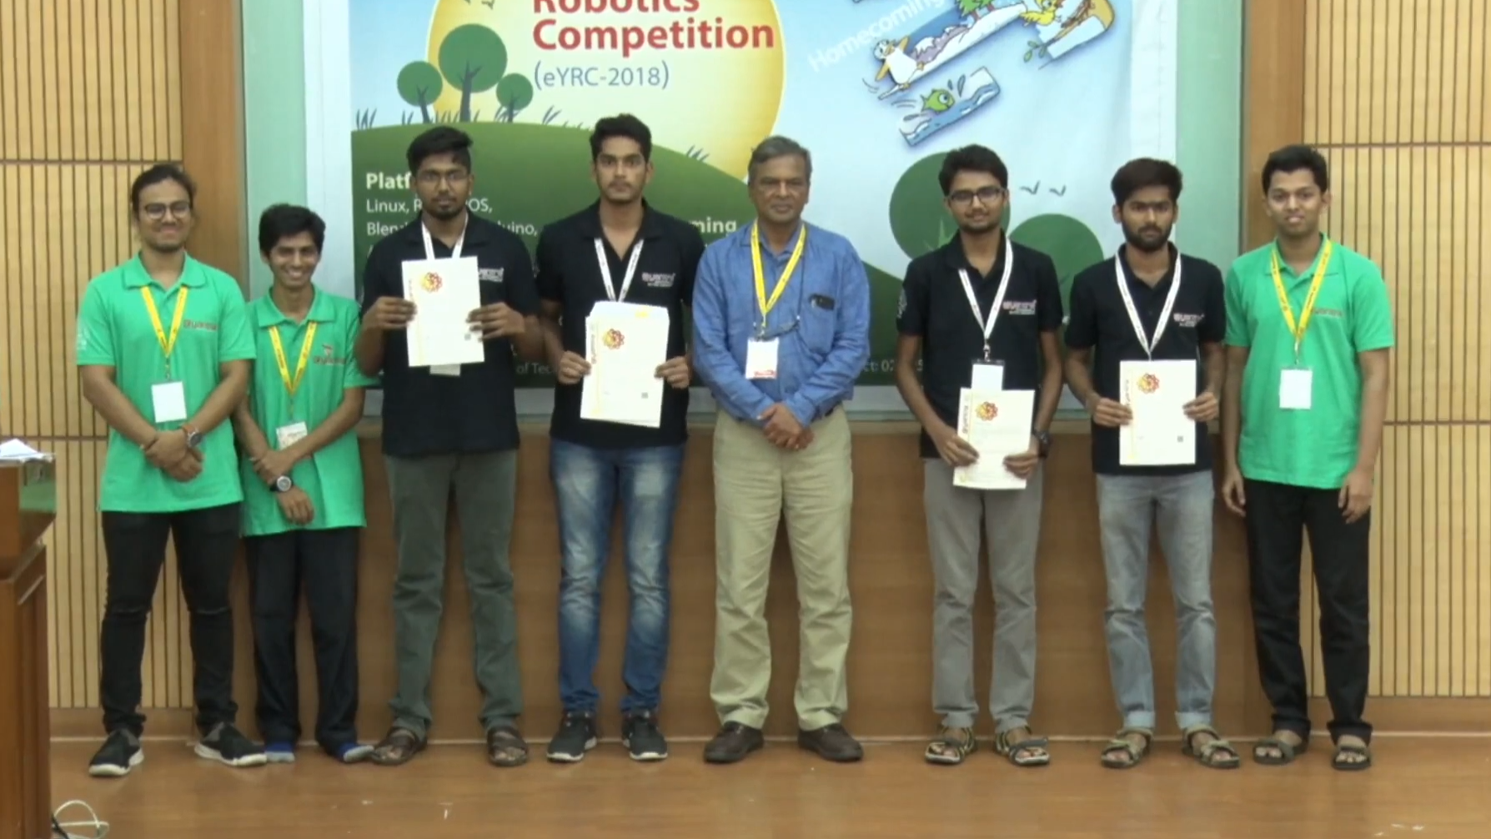
5th Position
Team Members:
Mahantesh R 3rd Year ECE
K L Hemanth Kumar 3rd Year ECE
Nischith B O 3rd Year ECE
Aman Bhat 3rd Year ECE

